Slide 1
CHILDHOOD LEAD POISONING
Montclair Health Department
Created by Diana Choque, BSN, RN
Notes:
• Montclair Health Department is proud to present your guide to Childhood Lead Poisoning. We will be reviewing lead’s harmful effects on children, how your family can be exposed to lead, how to appropriately test your child for lead, and ways you can help minimize your child’s risk of lead poisoning.

Slide 2
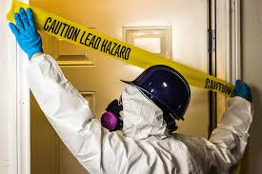
What is lead?
Lead is a naturally occurring metal in the environment.
Lead is a neurotoxin, a substance that affects the brain and nervous system.
Before its harmful effects were known, lead was used in house paint, gasoline, plumbing, toys, and more.
Notes:
• Lead is a naturally occurring metal in the environment and one of the earliest metals discovered by man. Not only was it an abundant resource and easy to mine, lead is inexpensive, easily recycled, can tolerate outside weather elements, and is easy to work with. Its resourceful properties made its way to our man-made products like house paint and gasoline, even into medicines and cosmetics.
• Unfortunately, lead is dispersed throughout our environment and has been identified as a neurotoxin, a substance that affects the brain and nervous system.

Slide 3
Why is it harmful?
When lead is swallowed or inhaled, it can be very harmful for children, and may result in:
hyperactivity
trouble concentrating
behavioral problems
loss of appetite, nausea, and vomiting, weight loss
constipation
feeling tired
muscle and joint weakness
developmental delays
Notes:
• Because of its long-term environmental persistence, lead does not lose its toxic potential, even if ingested. Children ages 1 – 6 are the most vulnerable due to developmental habits, like crawling, playing, and hand-to-mouth behaviors, such as sucking their fingers or biting nails.
• When lead is swallowed or inhaled, it may result in:
Hyperactivity, trouble concentrating, behavioral problems
loss of appetite, nausea, vomiting, weight loss, and constipation
feeling tired, muscle and joint weakness, developmental delays
• Extremely high concentrations of lead in one’s system can lead to convulsions, coma, and death.

Slide 4
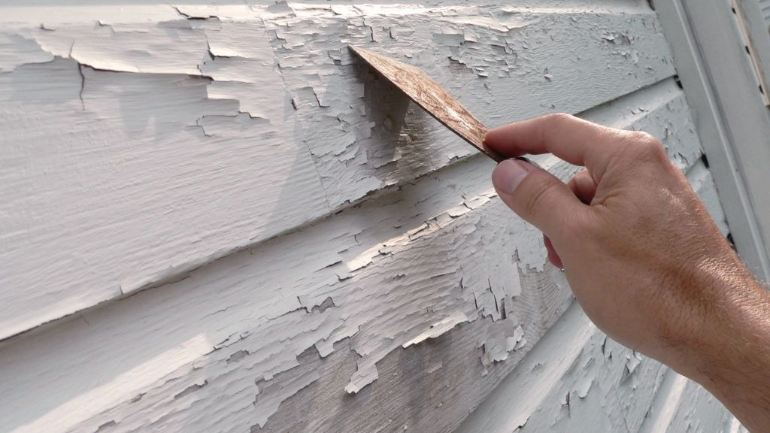
The most common way that kids get lead poisoning is from lead-based paint.
This type of paint was used in many U.S. homes until the late 1970s, when the government banned the manufacturing of paint containing lead.
Lead paint is still found in many homes today; what happens when it peels, chips, or flakes off?
Young children put these pieces of paint in their mouths or pieces become part of household dust.
Notes:
The most common way that kids get lead poisoning is from lead-based paint.
In the early 1900s, numerous cases of child lead poisoning were recorded by pediatricians who suggested lead paint in homes was responsible. Doctors concluded freshly painted or sticky surfaces, and surfaces that were well worn and powdery would most likely induce poisoning. Lead contaminated dust could easily spread throughout homes.
Although the government banned the manufacturing of paint containing lead in 1978, lead poisoning remains a serious public health hazard. Lead can be found in many homes today; what happens when it peels, chips, or flakes off?
Young children put these pieces of paint in their mouths or pieces become part of household dust.

Slide 5
How do children get lead poisoning?
Kids also can come into contact with lead through:
Soil near busy roadways and around homes that were painted with lead-based paint
Water that flows through old lead pipes or faucets
Imported goods, such as jewelry, lead glazed pottery, toys, candy and spices
Folk remedies, such as greta and azarcon (used to treat an upset stomach)
Notes:
Other common sources of lead include soil, water, imported goods, and unconventional medicines.

Slide 6
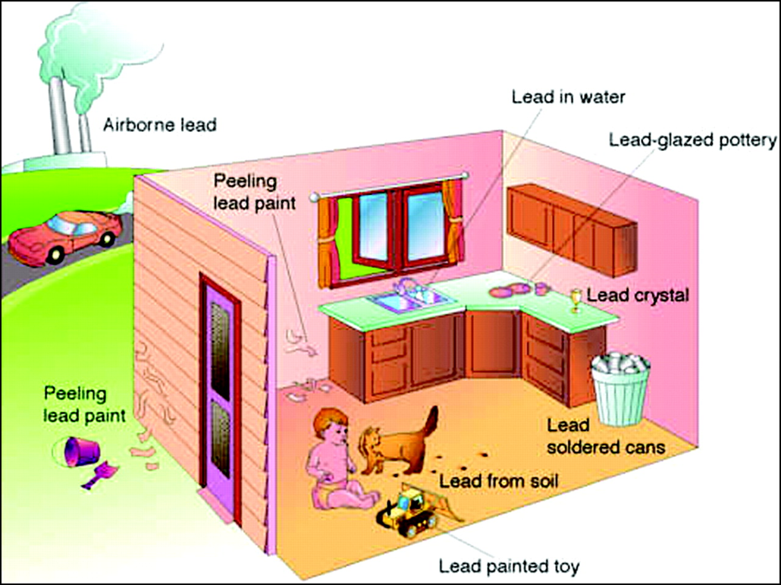
Is your child lead-safe?
Notes:
Lead is an environmental hazard. Children can be affected by lead contamination in what they eat, drink, touch, or breathe.
Due to the immaturity of the blood-brain barrier, any lead ingested is directly absorbed into the body.
Nutritional status, low calcium and iron deficiency can increase absorption of lead. Lead contaminated dust can enter into the blood, seep into the soft tissues of the brain and into the bone, when it can stay for years depending on the length of exposure.

Slide 7
Has your child been tested for lead?
A small sample of blood from a finger or vein (more accurate) is needed to test how much lead is present.
NJ State lead testing guidelines mandate children be tested at 1 and 2 years old.
High-risk children:
Live in or regularly visit a home built before 1950
Live in or regularly visit a home built before 1978 that has recently been remodeled
Have a sibling with lead poisoning
Have parents who are exposed to lead at work
Moved to the U.S. from another country
Notes:
Has your child been tested? New Jersey State mandates pediatricians to screen children for lead at ages 1 and 2 years old. A blood test is the only way to know if your child has been exposed. This can be done through a fingerstick or venous sample, although venous is more accurate.
A venous lead level of 5 ug/dL or higher warrants intervention from your local health department, but no lead level has been identified as safe for children.
Children at highest risk include those living in older homes; ones who have siblings exposed to lead; parents who work in construction, auto mechanics, as fishermen, with firearms, or work with paint, stained glass, and ceramics; and those who have immigrated from another country where lead is not regulated.

Slide 8
Keep Lead Out!
Wash children’s hands before meals, before sleeping and after playing outdoors.
Wash toys and pacifiers after use.
Do not allow children to play in dirt.
Use cold water for cooking, drinking, and making baby formula.
Run cold water 1 minute before use.
Wet mop floors and damp dust windowsills regularly.
Leave shoes at the door.
If family member works with lead (auto mechanic, construction worker, fisherman), wash work clothes separately.
Keep children away from chipping and peeling paint.
Learn about lead-safe practices for painting, repairing, and renovating a pre-1978 home.
Notes:
When counseling our parents, we provide these tips to help reduce their children’s risk of exposure.
Reinforce handwashing - before meals, before sleep, after playing.
Discourage hand to mouth behaviors.
Keep children away from chipping and peeling paint – block it with furniture or cover it with duct tape or contact paper.
Keep children away from dirt, and keep shoes at the door. Be mindful of pets.
Run cold water for 1 minute to flush any lead that sunk in the pipes.
Before renovating or repairing parts of your home, learn more about lead-safe practices.
Wet mop floors and wet wipe windowsills to collect lead contaminated dust from outside.

Slide 9
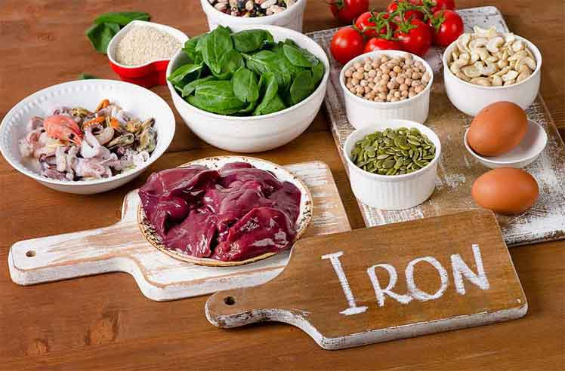
Nutrition: more iron, vitamin C, and calcium
Vitamin C helps the body absorb iron better.
Foods rich in vitamin C include:
Tomatoes, bell peppers, oranges, strawberries, cantaloupe, sweet potatoes, kiwis, kale
Iron blocks lead from being absorbed.
Try these iron-rich foods:
Lean meats, poultry, iron-fortified cereals, beans, peas, spinach, dried fruit
Calcium keeps your bones strong and the lead out.
Calcium-rich foods include:
Milk, cheese, yogurt, salmon, kale, spinach, collard greens
Notes:
Handwashing and nutrition are the two most effective ways to excrete lead from your child’s system.
Medication is only recommended with lead levels greater than 40 ug/dL, which could warrant hospitalization.
Provide your child with foods high in iron – to block lead absorption; high in vitamin C – to help absorb the iron; and more calcium – to keep lead out of bones.

Slide 10
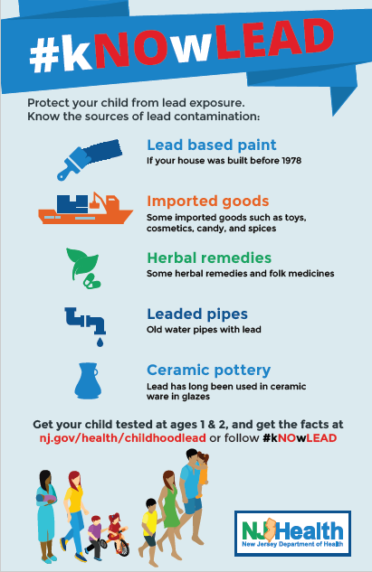
#kNOwLEAD
Get your child tested at ages 1 and 2 and
get the facts at nj.gov/health/childhoodlead
Check for recalls of toys, toy jewelry or other
products found to have lead and visit www.cpsc.gov
For more information, contact
Montclair Health Department at (973) 509 - 4970.
Notes:
For more information about New Jersey’s #kNOwlead campaign, please visit NJ’s Department of Health webpage on childhood lead. There you can find resources and education materials to learn more about prevention and testing.
Visit US Consumer Product Safety Commission’s webpage to learn more about products that have been recalled for lead hazards.
If you are a Montclair resident and would like to learn more about upcoming lead awareness events near you, please call the health department for more information.

Slide 11
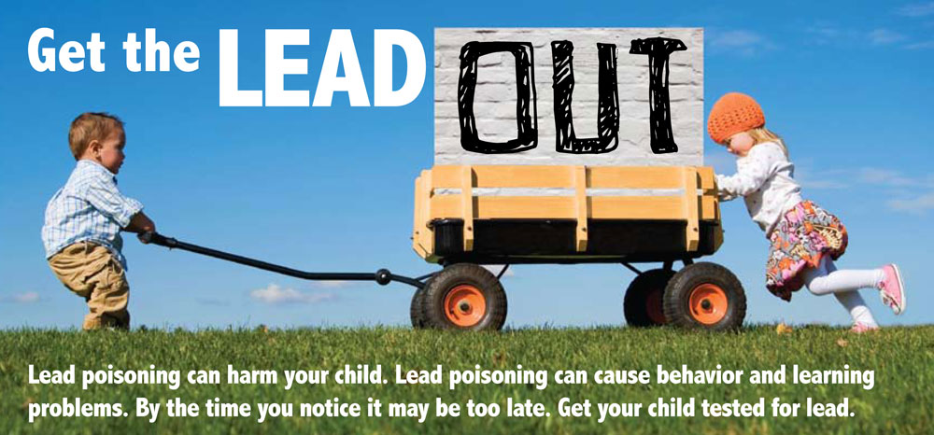
Notes:
Lead levels considered safe in the past are now considered hazardous. No lead level is safe for children.
The only way to know if your child has been exposed to lead is get your child tested.

